Slide 1
Learning objectives
Distinguish between management accounting and financial accounting
Outline the development of management accounting
Appreciate the roles of budgets and budgetary control
Understand manufacturing accounts and basic costing terminology
Distinguish between absorption costing and marginal costing
Outline the main areas of management accounting

Slide 2
Management Accounting
The process of collecting, collating and reporting information that is of use to the managers of a business
Management accounting information for:
Costing services and products
Planning and budgeting
Decision making
Budgetary control

Slide 3
Origins of Management Accounting
Evolved in 20th Century
To help with planning and decision making in a systematic way
Small businesses may not need management accounts

Slide 4
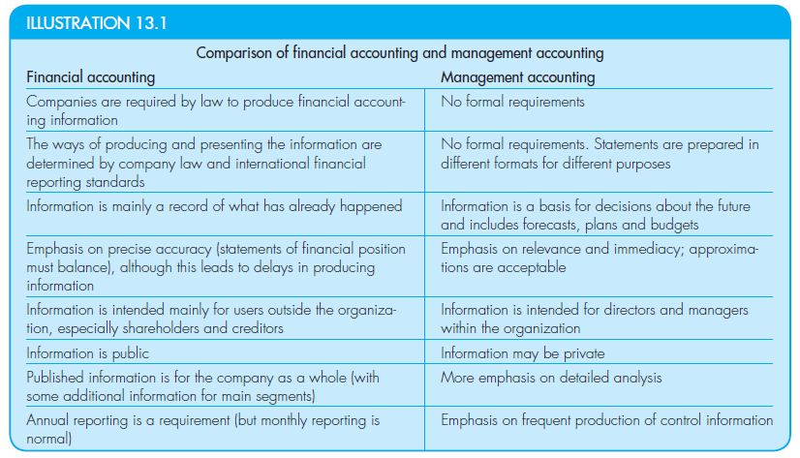
Management Accounting vs. Financial Accounting

Slide 5
Manufacturing accounts
Links financial and management accounting through inventory valuation
3 inventory accounts
Direct materials – Calculate the cost of direct materials consumed during the period (as opposed to the direct materials purchased during the period).
Work in progress – Calculate the costs incurred in making finished goods (and to exclude the costs incurred in manufacturing items that are not completed during the period and so are not available for sale).
Finished goods – Calculate the cost of the goods that were actually sold (and to exclude closing inventories of finished goods that were available for sale, but not sold).

Slide 6
Costing of products in a manufacturing business
Absorption cost principles : Production cost comprises the sum of
Direct material
Cost of material used
Direct wages
Wages paid to operatives
Direct expenses
Production overhead

Slide 7
Terminology
Prime costs is the sum of all direct costs
Production costs
Prime costs + Production overheads
Period costs
Non manufacturing costs
Operating expenses

Slide 8
Terminology
Fixed costs are costs which, within a stated range of output continue at the same amount
E.g. Rent, Rates
Stepped fixed costs
Beyond range fixed costs may increase
Variable costs change directly in line with the volume of production.
E.g. Direct material costs
Semi-variable costs are those with a fixed annual cost and a variable cost per unit consumed.
Utility costs such as electricity, telephone

Slide 9
Budgetary control
A budget is a financial plan
What the company expects the future to look like
Acts a target against which comparisons are made
Control
Budgeted Income statement
Budgeted Statement of financial position

Slide 10
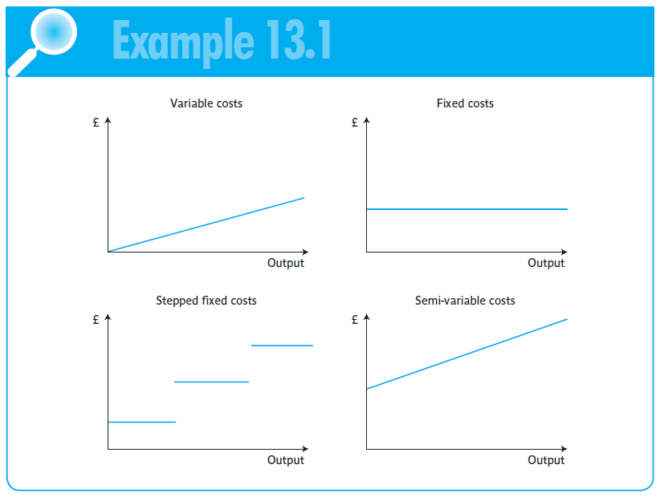
Different costs

Slide 11
Absorption and Marginal Costing
Absorption costing
Used for product costing
Includes full cost of overheads
Used in financial accounting for inventory valuation and profit calculation
Marginal costing
Identifies costs as variable or fixed
Provides relevant costs
Used in decision making

Slide 12
Standard costing and variance analysis
Standard costing
Planned unit costs
Useful for planning and control
Actual costs may fluctuate
Variance analysis
Comparison of planned costs and actual costs
Enables an analysis of performance where planned and actual activity differ
Action may be taken to investigate differences

Slide 13
Developments in Management Accounting
Management accounting is constantly developing to meet the needs of businesses
More accurate ways of identifying overhead costs with particular products and activities
Activity based costing
As international businesses have become more competitive, a new technique emerge
Balanced Scorecard

